Slide 1

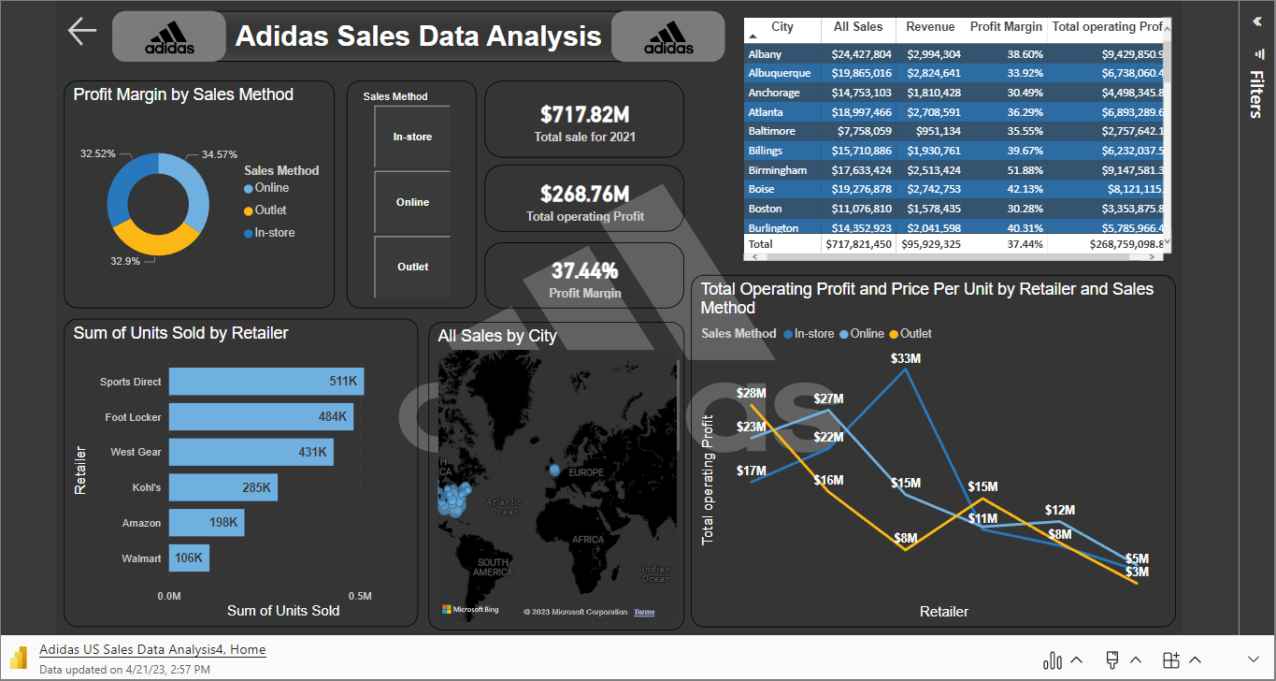
Adidas Sales Data Analysis Report

Slide 2
Adidas Sales Data Analysis Report
Sales Insights:
Adidas sales in 2020-2021 = $ 899.99M
  2020 Sale - 182.08M
  2021 Sale - 717.82M
Overall Profit = $ 332.13M
  2020 Profit - $63.38M
  2021 Profit - 268.76M
Profit Margin 2020 - 34.81%
Profit Margin 2020 - 37.44%
Total Unit Sold - 2478861
  2020 - 462349
  2021 - 2016512
Highest Sales by West Region -- 269.94M which is 30% of total sales
  2020 - 76.9M - 42.23%
  2021 - 193.05M - 26.89%
Highest Revenue by West region --> 36.44M which is 30.32% of total Revenue
  2020 - $ 10.02M
  2021 - $ 26.42M
Top Product sold - Mens Street Footwear - $208.83M which is 23.21%
Min Product sold - Women's Athletic Footwear - $106.63M which is 11.85%
Top Retailer by Sale - $242.96M which is 27% of the overall sale
Avinash Ghodse.

